Slide 1

Networks
and Choice Modeling
Xuling Yang
Mentor: Apara Venkat
SPA DRP, WI21
Notes:
Some motivation

Slide 2

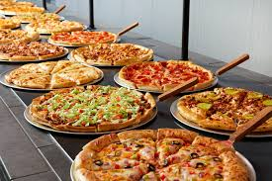


We need to make choices every day...

Slide 3
Utilities of Decisions
“Usefulness; the quality of being of practical use”
the benefit that the chosen option brings to you
Choose the “best” by comparing utilities of options
Predict the choice probability of a customer
Build a mathematical model for utilities?
Discrete Choice Models

Slide 4

Discrete Choice Models (DCM)
decision maker
alternatives/the choice set
3 criteria of defining the choice set
mutually exclusive:
exhaustive:
finite(restrictive*):
(example: restaurant--food menu)
only one dish
lists all the possible dishes or combinations
not sold by pieces

Slide 5

Utility in DCM
Utility: U = β’x + ε
x, a vector of observed factors
material, price, quality
ε, a variable of unobserved factors
city to live
β, a vector of parameters
weight of different factors

Slide 6
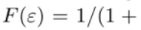
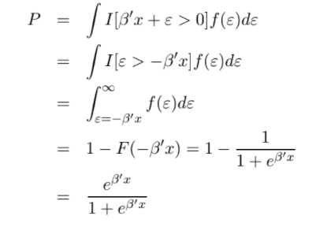
Choice Probability in DCM
PDF of ε:
CDF of ε, logit:
Choice Probability:
logit!

Slide 7
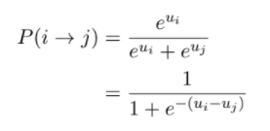
Choice Probability in DCM
Another definition of probability by comparison
Bradley-Terry-Luce Model (BTL), when i is preferred rather than j:
Only pairwise comparison
hard to deal with rankings with lots of options
Also logit!
Difference can be important!

Slide 8
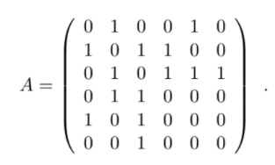
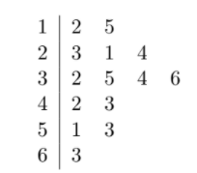
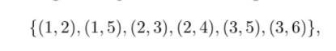
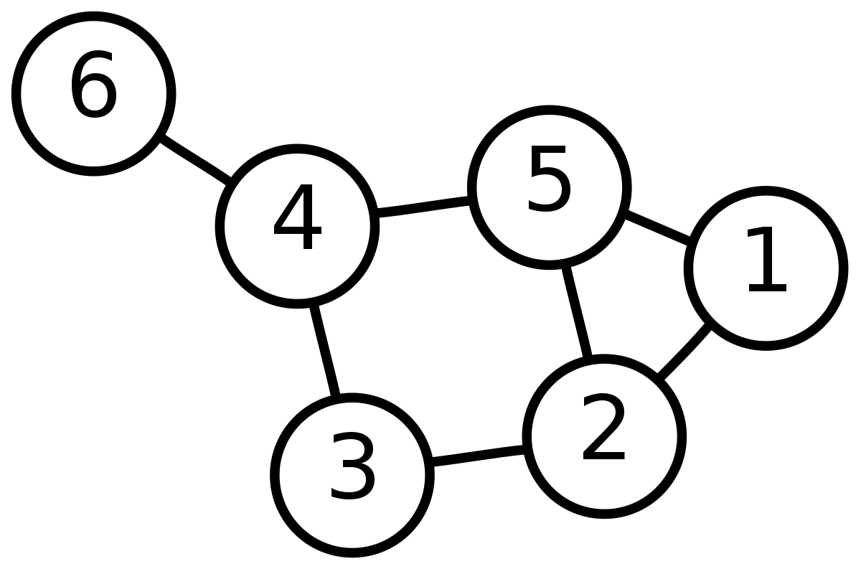
Networks
a graph formed by vertices and edges
a simple graph:
Reflects relationship between nodes
...Great tool for rankings!

Slide 9
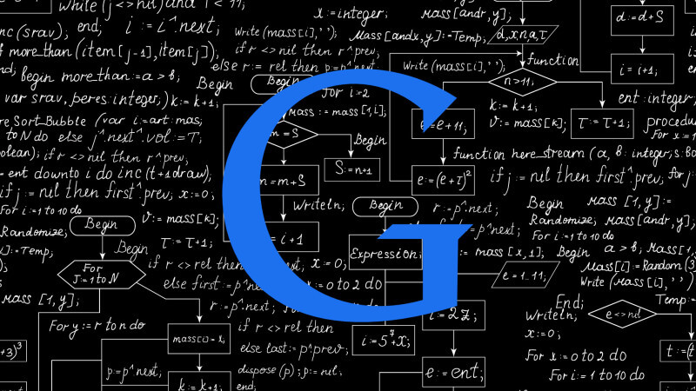
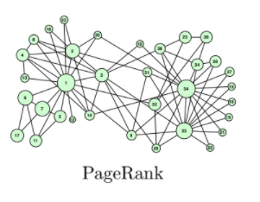
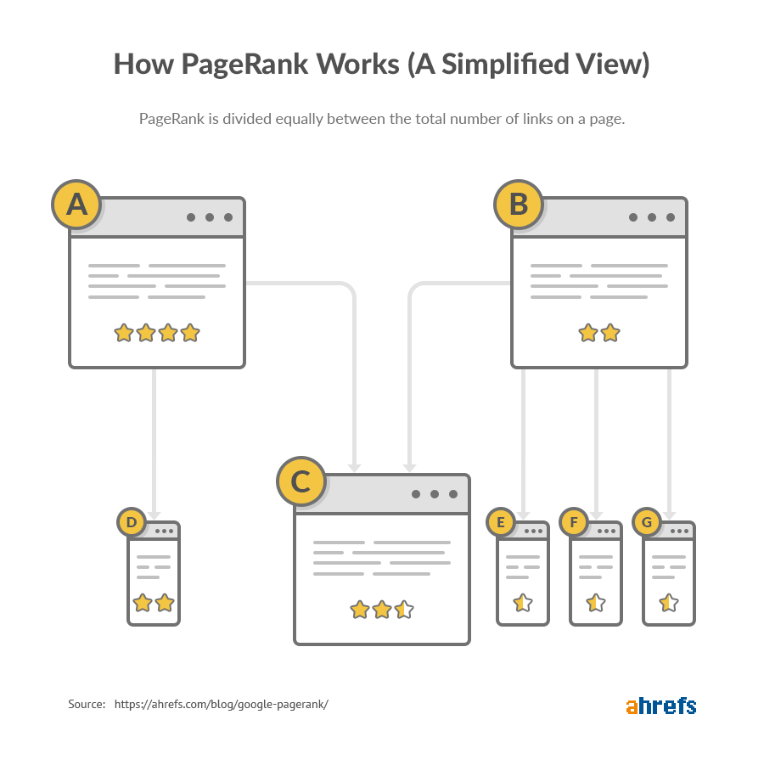
PageRank: by structural importance

Slide 10

Question: from networks to choice model?
Ranking methods like PageRank:
mostly based on degrees and geodesic distances
assigned original utility
very coarse ordinary ranking
scores no actual meaning
not follows logit distribution
how to reconcile utility and networks?
….SpringRank!

Slide 11
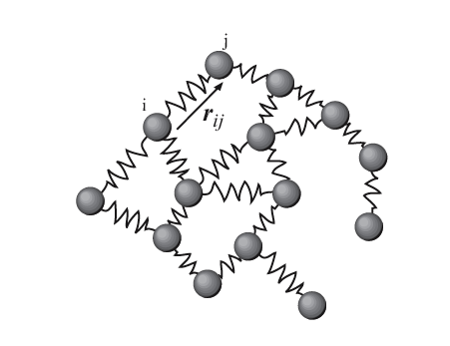
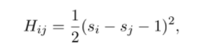
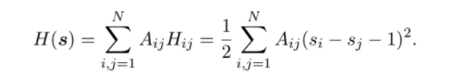
Reconciliation: SpringRank
physical system: nodes vs. options; springs vs. edges
energy decided by distances between nodes
minimize the total energy of the system to get optimal rankings

Slide 12
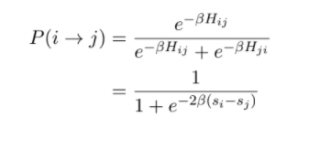
Reconciliation: SpringRank
With Boltzmann distribution, we can also get a logit model!
SpringRank
BTL
SpringRank can be used as Discrete Choice Model in some ways?
...Still a long way to go!

Slide 13
Bibliography
Kenneth Train. “Discrete Choice Methods with Simulation.” March 8, 2002
Clauset and Larremore. “Network Analysis and Modeling, CSCI 5352 Lecture Notes.”
Caterina De Bacco, Daniel B. Larremore, and Christopher Moore. “A Physical Model for Efficient Ranking in Networks.”
Aparajithan Venkateswaran. “Understanding SpringRank through Random Utility Models, Identifiability, and Online Updates.” 2020

Slide 14
Thanks for watching!

